Slide 1

Bridging the Gap Between Database and Stream
Per Minborg CTO, Speedment, Inc
Emil Forslund Developer, Speedment, Inc.

Slide 2



About Us
Per Minborg
Entrepreneur
+15 US Patent
Java expert
Palo Alto
Minborg’s Java Pot
Emil Forslund
Developer
Palo Alto
Java expert
Age of Java
Spire
Speedment open-source mascot
GitHub
3 years of mascot experience

Slide 3

Why Should You Need to Use SQL?
Notes:
Whenever you write code that mixes languages and domains, such as Java and SQL, you are going to get bugs. A solution is to move away from query languages such as SQL and instead write your business logic with the type-safe and object-oriented constructs we have learned to love in Java, such as streams, predicates, and functions. In this session, you will rediscover the power of the Stream interface in a completely new domain: relational databases. You will also learn how nicely it blends in with your existing application, even with no modifications on the database layer. This will not only increase your productivity but also help you build safer and more maintainable Java code.

Slide 4
Why Should You Need to Use SQL?
SQL | Stream Operations
FROM | stream()
SELECT | map()
WHERE | filter() (before collecting)
HAVING | filter() (after collecting)
JOIN | flatmap() or map()
DISTINCT | distinct()
UNION | concat(s0, s1).distinct()
ORDER BY | sorted()
OFFSET | skip()
LIMIT | limit()
GROUP BY | collect(groupingBy())
COUNT | count()
Notes:
When the same semantics can be derived directly from Java 8 or 9 streams?

Slide 5
Both Stream and SQL Have Declarative Constructs
SELECT * FROM FILM
WHERE RATING = ’PG-13’
films.stream()
.filter(Film.RATING.equal(Rating.PG13))
Notes:
They describe result rather than state instructions on how to compute the result

Slide 6
Short Demo
Notes:
In the following, an example is shown where the task is to print out all Film entities having a rating of “PG-13” (meaning “Parents are Strongly Cautioned” in the US). The films are located in a database table represented by a Speedment Manager variable named films in this code snippet:
SELECT COUNT(*) FROM `sakila`.`film`

Slide 7

Why We Developed Speedment
Create a new DB app took hours
Too much boilerplate ORM code
Mixing SQL and Java
Slow…
Notes:
We are Java developers and a while ago we got the task to develop a dabase application. We run into following problems.

Slide 8

Speedment Open Source Project
Pure Java for entire application
Type safety
Lazy evaluation of stream
Apache 2 license
3:rd most popular Java ORM on Github!
2015
2017
Notes:
Only a minimum set of data is actually pulled from the database into your application

Slide 9
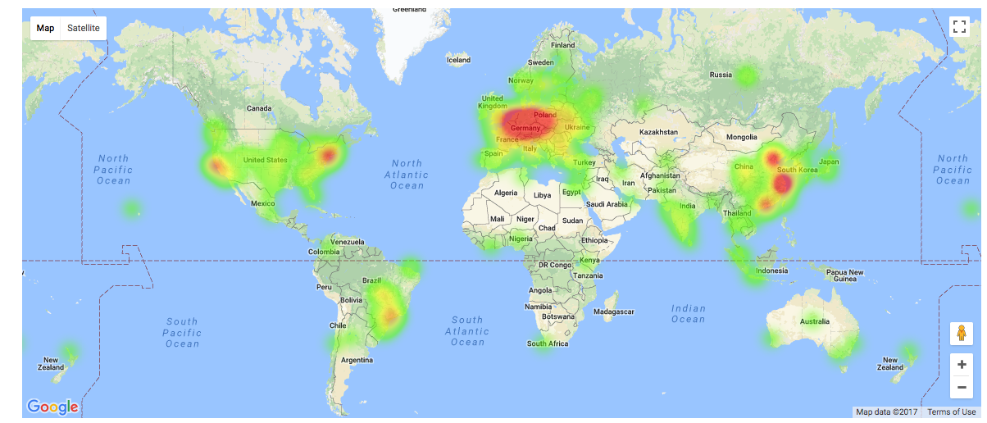
Notes:
We are happy to have open-source supporters from all over the world.

Slide 10
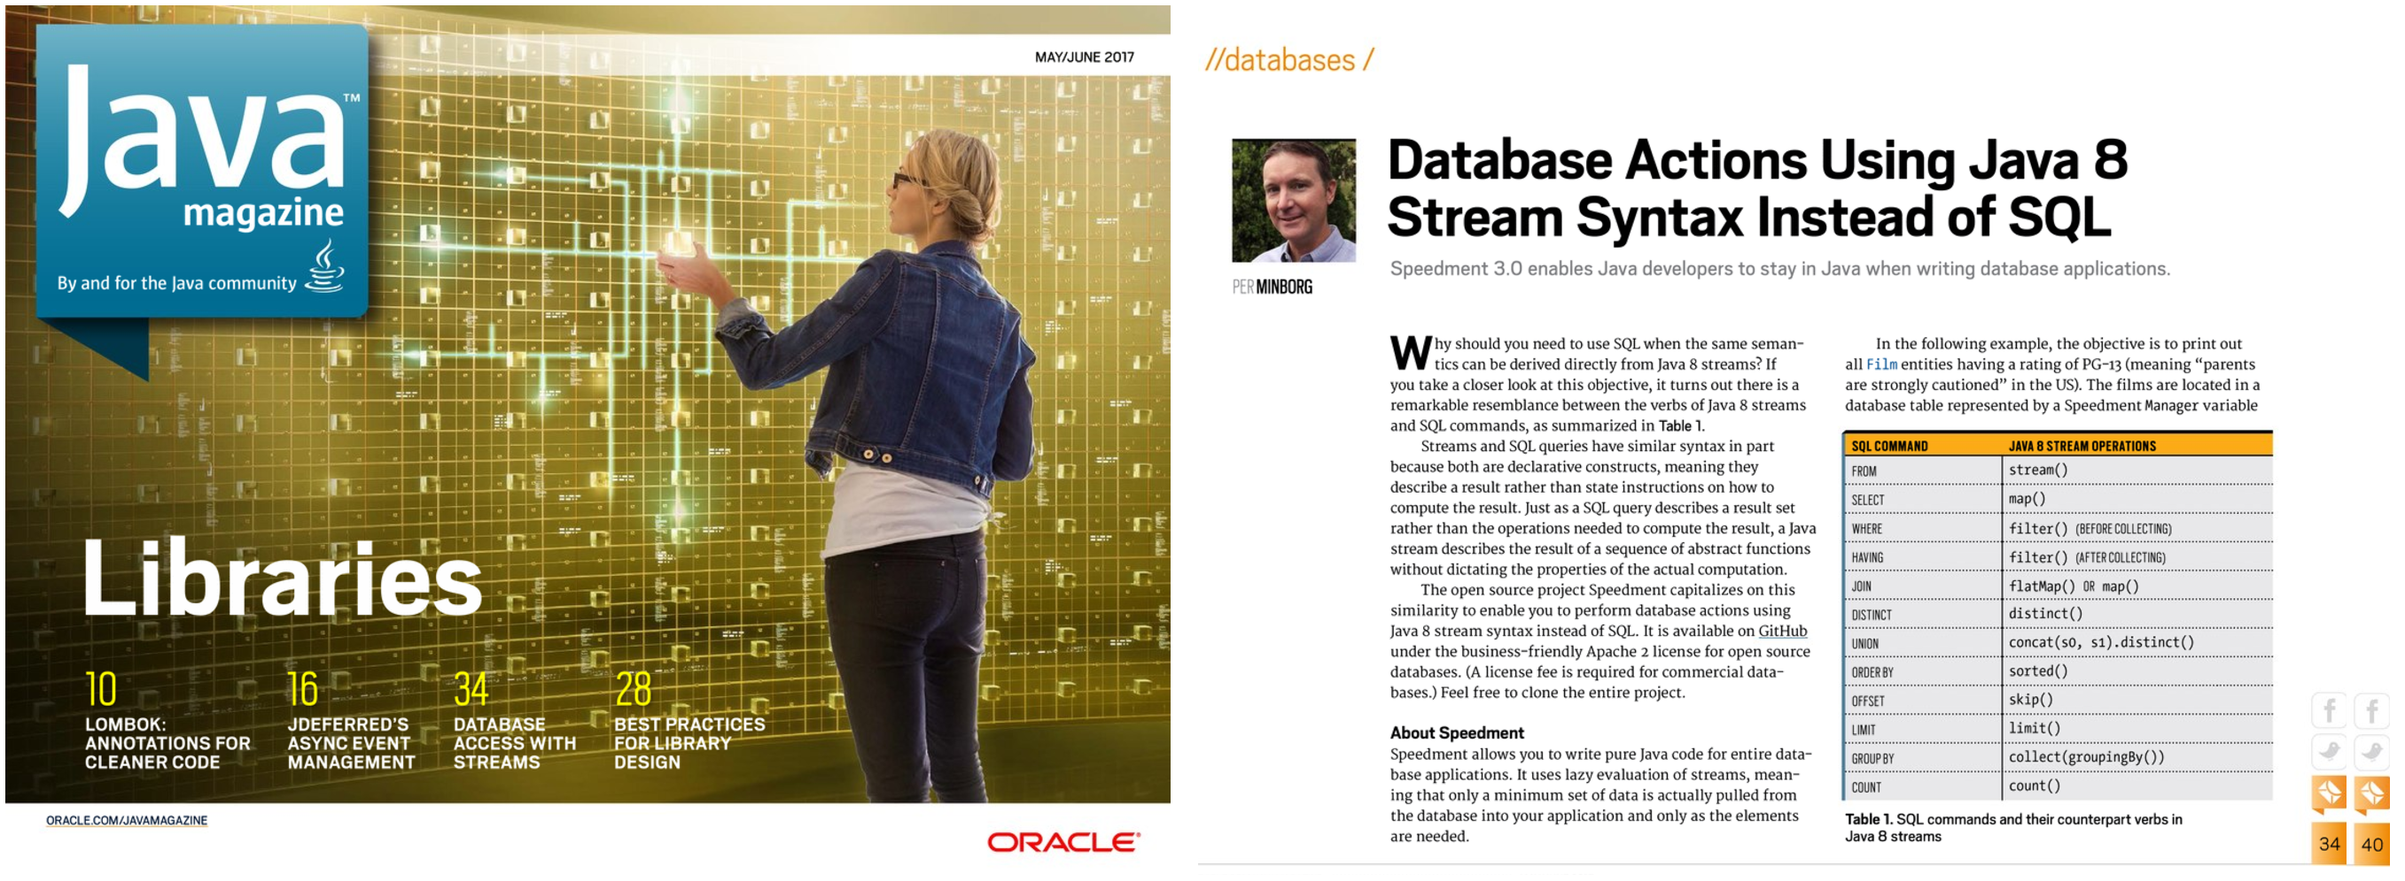
Notes:
This talk is inspired from an article I wrote this year in Oracle Java Magazine

Slide 11

How it Works
Connects seamlessly to database
Lazily pulls data as streams are consumed
Stream introspects its own pipeline before it starts
Operations such as filter() and sorted() can be moved from the stream’s pipeline into a SQL query
Notes:
If you have worked with Java 8 Streams before, the previous example and those that follow will look familiar. Xxxx Let us take a closer look at how this will affect Java database applications.

Slide 12
Both Stream and SQL Have Declarative Constructs
films.stream()
.filter(Film.RATING.equal(Rating.PG13))
SELECT * FROM FILM
WHERE RATING = ’PG-13’
Notes:
They describe result rather than state instructions on how to compute the result

Slide 13
Database Collations vs. Java
films.stream()
.filter(Film.RATING.equal(Rating.PG13))
SELECT * FROM FILM
WHERE RATING = ’PG-13’
COLLATE utf8_bin

Slide 14
Columns Present in the Domain Model
films.stream()
.filter(Film.RATING.equal(Rating.PG13))
SELECT
`film_id`,`title`,`description`,`release_year`,
`language_id`,`original_language_id`,`rental_duration`,`rental_rate`,
`length`,`replacement_cost`,`rating`,`special_features`,
`last_update`
FROM
`sakila`.`film`
WHERE
(`sakila`.`film`.`rating` = ? COLLATE utf8_bin)

Slide 15
Sorting
films.stream()
.filter(Film.RATING.equal(Rating.PG13))
.sorted(Film.TITLE.comparator())
SELECT
`film_id`,`title`,`description`,`release_year`,
`language_id`,`original_language_id`,`rental_duration`,`rental_rate`,
`length`,`replacement_cost`,`rating`,`special_features`,
`last_update`
FROM
`sakila`.`film`
WHERE
(`sakila`.`film`.`rating` = ? COLLATE utf8_bin)
ORDER BY
`sakila`.`film`.`title` IS NULL,
`sakila`.`film`.`title` COLLATE utf_bin ASC

Slide 16
Do You Recognize This Code?
Class.forName("org.postgresql.Driver");
try (Connection conn = DriverManager.getConnection(
"jdbc:postgresql://hostname:port/dbname",
"username",
"password”);
PreparedStatement ps = conn.prepareStatement(”SELECT * FROM FILM …
ResultSet rs = …
) {
while (rs.hasNext()) {
Film film = new Film(
rs.getTitle(),
…
)
doSomething(film);
}
} catch …
How many times have you copied this from the WEB?
Notes:
Ice-breaker

Slide 17

Lazy Evaluation
films.stream()
.filter(Film.RATING.equal(Rating.PG13))
.limit(10)
.forEach(doSomething());

Slide 18

Parallel Execution
films.stream()
.parallel()
.filter(Film.RATING.equal(Rating.PG13))
.forEach(expensiveOperation());

Slide 19
Write Your Own Parallel Executor with JDBC…

Slide 20

JShell Demo
Notes:
In the following, an example is shown where the task is to print out all Film entities having a rating of “PG-13” (meaning “Parents are Strongly Cautioned” in the US). The films are located in a database table represented by a Speedment Manager variable named films in this code snippet:
SELECT COUNT(*) FROM `sakila`.`film`

Slide 21
Expressing Queries as Streams
Standard Stream API
Full Type-Safety
films.stream()
.filter(Film.RATING.equal(Rating.PG13))
.filter(Film.LENGTH.greaterThan(75))
.count();
SELECT COUNT(*) FROM ’film'
WHERE ’rating’::bytea = ‘PG-13’::bytea AND ’length' > 75;
SELECT COUNT(*) FROM ’film'
WHERE ’rating' = ‘PG-13’ COLLATE utf8_bin
AND ’length' > 75;
Only 1 value is loaded from DB
Notes:
Pause before the fourth arrow
”Do you know what the coolest aspect of this paragraph is?”

Slide 22
Querying the Database Using Streams
SELECT * FROM ’film'
Pipeline
Source
Film.RATING.equal(Rating.PG13)
Filter
Film.LENGTH.greaterThan(75)
Filter
count()
Term.

Slide 23
Querying the Database Using Streams
SELECT * FROM ’film'
WHERE ’rating' = ‘PG-13’ COLLATE utf8_bin
Pipeline
Source
Film.RATING.equal(Rating.PG13)
Filter
Film.LENGTH.greaterThan(75)
Filter
count()
Term.

Slide 24
Querying the Database Using Streams
SELECT * FROM ’film'
WHERE ’rating' = ‘PG-13’ COLLATE utf8_bin
AND ’length' > 75
Pipeline
Source
Film.LENGTH.greaterThan(75)
Filter
count()
Term.

Slide 25
Querying the Database Using Streams
SELECT COUNT(*) FROM ’film'
WHERE ’rating' = ‘PG-13’ COLLATE utf8_bin
AND ’length' > 75
Pipeline
Source
count()
Term.

Slide 26
Querying the Database Using Streams
SELECT COUNT(*) FROM ’film'
WHERE ’rating' = ‘PG-13’ COLLATE utf8_bin
AND ’length' > 75
Pipeline
Source

Slide 27
Is This Really Legit?
From the Java 9 Docs for Stream::peek
“In cases where the stream implementation is able to optimize away the production of some or all the elements (such as with short-circuiting operations like findFirst, or in the example described in count()), the action will not be invoked for those elements.”
Notes:
Maybe someone thinks that this is not the proper way to use streams

Slide 28

Understanding Optimization
films.stream()
.filter(Film.RATING.equal(Rating.PG13))
.filter(Film.LENGTH.greaterThan(75))
.map(Film::getTitle)
.sorted()
.count();
Notes:
Optimization of stream operations during introspection is not limited only to filter() operations. Consider the following stream example: This creates a stream where only those films having a rating of PG-13 and a lengthy of more than 75 minutes will appear in the stream. After filtering, the Film elements are mapped to String elements. This is possible because each film’s title is extracted from the film using the Film::getTitle method reference. After this step, the stream of string elements is sorted (according to the previously extracted titles in natural order) and finally all the sorted strings are counted.

Slide 29
Understanding Optimization
Do this:
filter(Film.LENGTH.greaterThan(75))
Rather than this:
filter(f -> f.getLength() > 75)
Notes:
Upon introspecting the stream, Speedment determines neither the map() nor the sorted() operator will have any effect on the final count() outcome, because these operators do not change the number of elements in the stream. The operator map()changes only the type of the elements and sorted() only changes the order of the elements in which they appear in the stream. So, eventually the stream will be reduced and rendered to the following SQL query:
The code above will produce the following output:

Slide 30
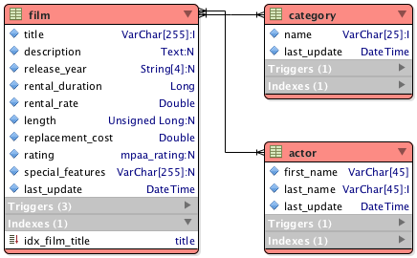
Basic Examples
Sample film database called “Sakila”
Speedment:
Connects to the DB
Extracts schema metadata
Generates Java code
Notes:
It was developed as a sample database by the MySQL team and has been available for about ten years. The sample database is open-sourced and available directly from Oracle. The code generator generates objects corresponding to the selected database tables. Managers are used for creating streams and other table-related operations.

Slide 31
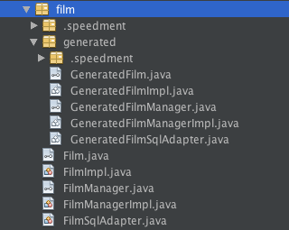
Basic Examples
Film
Java entity interface
Generated from the “film” table
Getters and setters for all columns
FilmManager
Create streams
FilmImpl and FilmManagerImpl
Default implementation
Or write your own
Notes:
It was developed as a sample database by the MySQL team and has been available for about ten years. The sample database is open-sourced and available directly from Oracle. The code generator generates objects corresponding to the selected database tables. Managers are used for creating streams and other table-related operations.

Slide 32
Speedment Project Demo
Notes:
In the following, an example is shown where the task is to print out all Film entities having a rating of “PG-13” (meaning “Parents are Strongly Cautioned” in the US). The films are located in a database table represented by a Speedment Manager variable named films in this code snippet:
SELECT COUNT(*) FROM `sakila`.`film`

Slide 33
Initializing Speedment
These classes are generated automatically
The application instance is configured using a Builder-pattern
SakilaApplication app = new SakilaApplicationBuilder()
.withPassword("sakila-password")
.build();
FilmManager films = app.getOrThrow(FilmManager.class);
A manager class is generated for every database table

Slide 34
Spring Integration
@Configuration
public class AppConfig {
private @Value("${dbms.username}") String username;
private @Value("${dbms.password}") String password;
private @Value("${dbms.schema}") String schema;
@Bean
public SakilaApplication getSakilaApplication() {
return new SakilaApplicationBuilder()
.withUsername(username)
.withPassword(password)
.withSchema(schema)
.build();
}

Slide 35
Spring Integration
// Individual managers
@Bean
public FilmManager getFilmManager(SakilaApplication app) {
return app.getOrThrow(FilmManager.class);
}

Slide 36
Spring Integration
@Autowired
private FilmManager films;

Slide 37
Serving Up a Spring REST Endpoint
int @Value(”app.pageSize:50”) pageSize;
@GetMapping(”/films/{rating}/{page}”) Stream<Film> pg(@PathVariable String rating, @PathVariable int page) {
return films.stream()
.filter(Film.RATING.equal(rating))
.sorted(Film.LENGTH.comparator())
.skip(page * pageSize)
.limit(pageSize);
}
Notes:
Writing web applications and REST endpoints using, for example, Spring Boot or Java EE is straightforward. In the following example, the task is to write a method serveFilms(String rating, int page) that returns a stream of Film entities. The rating controls the stream, allowing only films with the given rating to appear in the stream. If rating is null, then all films will be returned. Furthermore, the page parameter indicates which page to be rendered on the web user’s screen. The first page is page 0, the next is 1 et cetera. Finally, all films shall be ordered by length. This can be done like this:

Slide 38
Serving Up REST Endpoint
SELECT `film_id`,… ,`last_update`
FROM `sakila`.`film`
WHERE
(`sakila`.`film`.`rating` = ? COLLATE utf8_bin)
ORDER BY
`sakila`.`film`.`length` ASC LIMIT ? OFFSET ?
values:[PG-13, 50, 500]

Slide 39

Speedment Spring Plugin
Use the Speedment Spring Plugin to generate a working REST API
Open-source
Notes:
ive Demo, then Q&A

Slide 40
One-to-Many Relations
languages.stream()
.filter(Language.NAME.equal("English"))
.flatMap(films.finderBackwardsBy(Film.LANGUAGE_ID))
.forEach(System.out::println);
Notes:
In the example database, the tables film and language have a relation via a foreign key from film.language_id to language.language.id. Suppose the task at hand is to print all films that are in English, then this example is a way of doing it: This is how it works: First, the English language is filtered out. Then the actual relation between the tables is specified by applying a flatMap() operator. This operator takes a Function that maps from a Language to a Stream<Film> whereby the latter only contains Films matching the particular language. In short, the penultimate line takes us from a Stream<Language> to a Stream<Film>. This is a relation commonly referred to as a “one-to-many” relation because many films can point to the same language. Speedment is aware of the columns having foreign keys and only those columns can be passed to the finderBackwardsBy() method, which ensures full relational integrity at compile time.

Slide 41

CRUD Operations with Streams
languages.stream()
.filter(Language.NAME.equal("Deutsch"))
.map(Language.NAME.setTo("German"))
.forEach(languages.updater());
UPDATE LANGUAGE
SET NAME = ’German’
WHERE NAME = ’Deutsch’ COLLATE …
Notes:
With Speedment, as with any ORM, entities can be created, updated and deleted. These operations can be integrated with Java 8 streams as illustrated in the example below. Here, all language entities with a name “Deutsch” are to be renamed to “German”: First, the language to be changed is filtered out. Then a map() operation is added to the stream that, when applied, will take a Language entity and return a (possibly new) Language entity with the “name” field changed to “German”. On the last row, the language updater() will be called for each Language in the stream. As its name implies, a language updater() will take a Language and then locate and update the affected row in the database.
Remember, Speedment will optimize the stream and will only pull in those elements fitting the filter.

Slide 42
JUnit Testing
StreamSupplierComponent

Slide 43
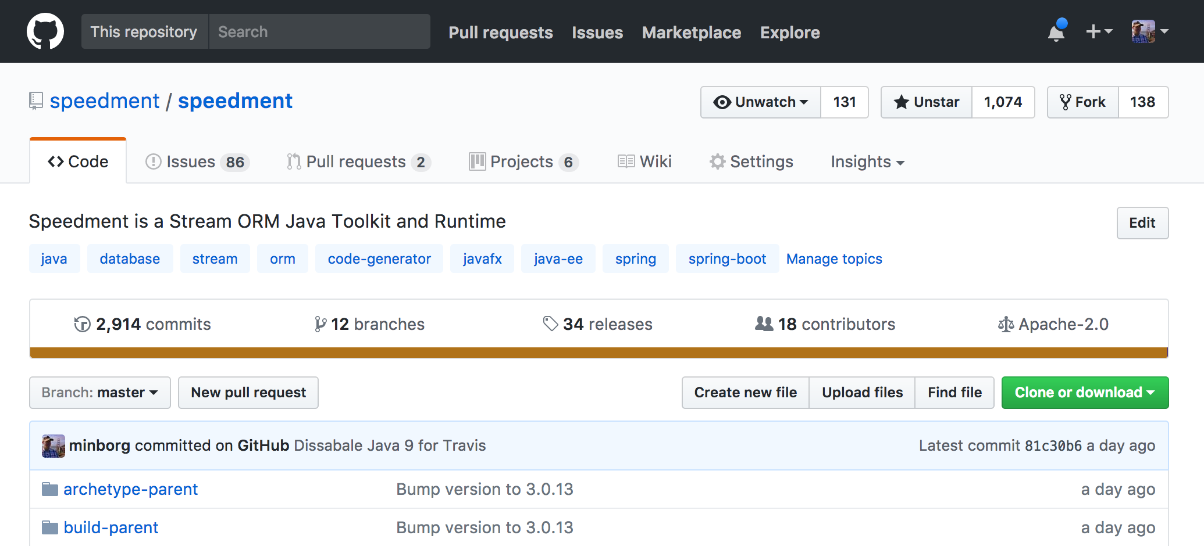

Get Started with Speedment

Slide 44
Getting Speedment using Maven
<plugin>
<groupId>com.speedment</groupId>
<artifactId>speedment-maven-plugin</artifactId>
<version>3.0.14</version>
</plugin>
Generate source files based on database

Slide 45
Getting Speedment using Maven
<dependency>
<groupId>com.speedment</groupId>
<artifactId>runtime</artifactId>
<version>3.0.14</version>
<type>pom</type>
</dependency>
Single runtime dependency with no transitive dependencies on other libraries

Slide 46
Initializer

Slide 47
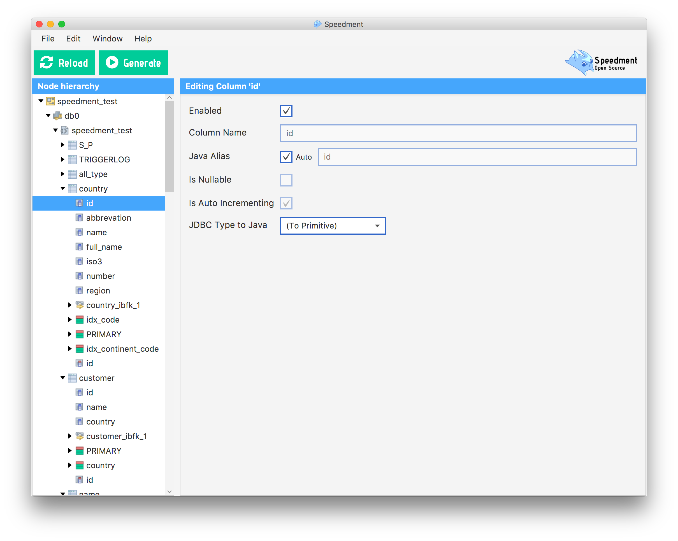
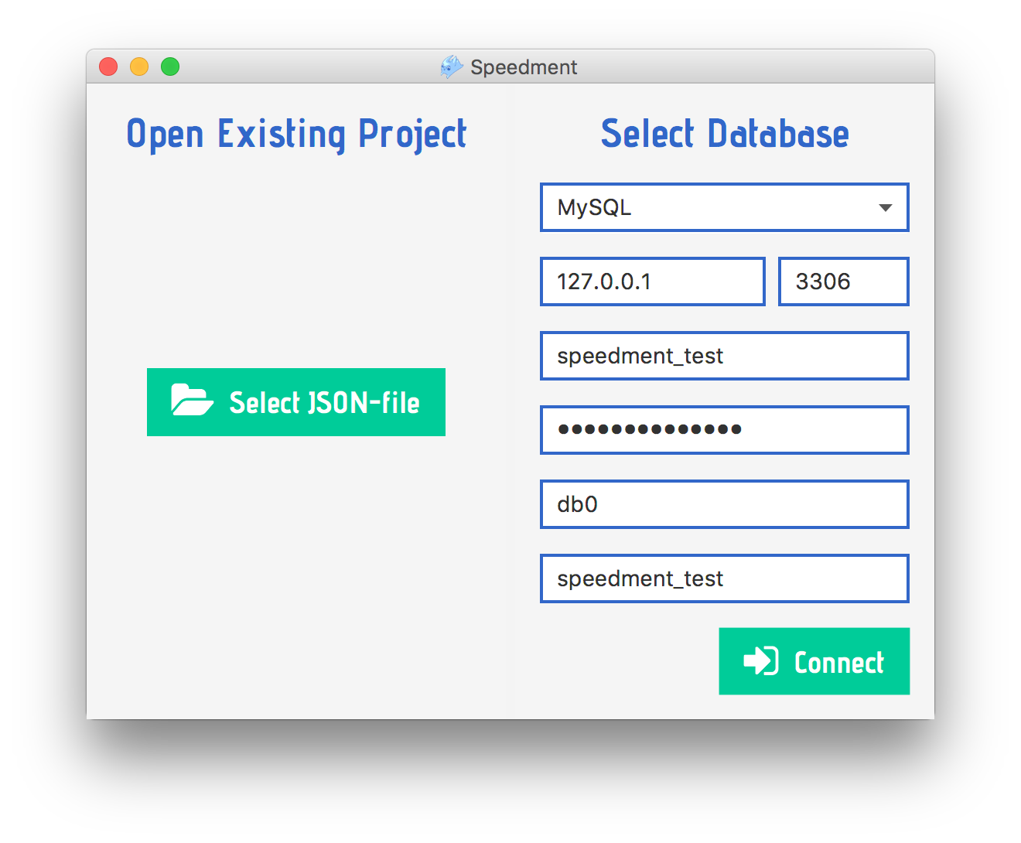
Get Started with Speedment
Notes:
Positives

Slide 48
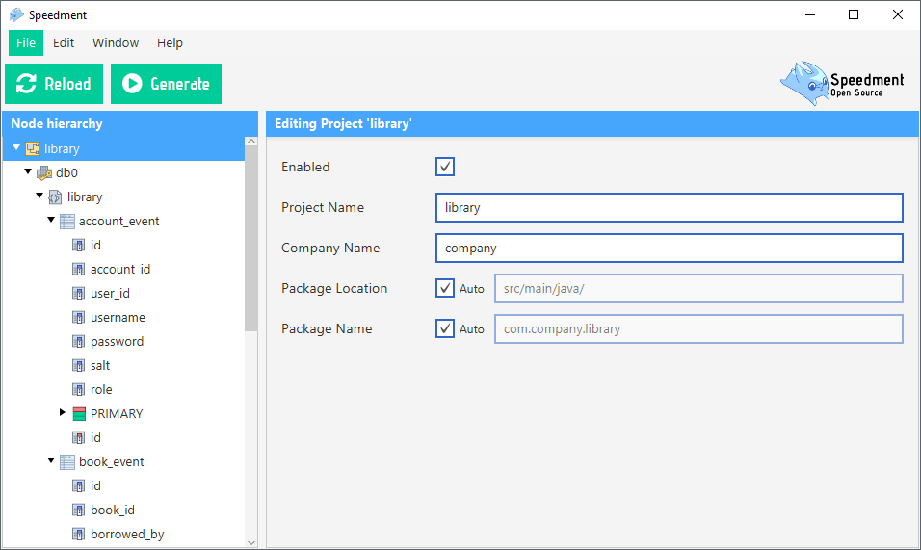
Get Started with Speedment
Step 1: Generate Code
Step 2: Write Logic
Step 3: Run Application
customers.stream()
.filter(…)
.filter(…)
.map(…)
.collect(toList());
Step 4: Iterate
Notes:
Agile Workflow

Slide 49




Speedment OpenSource Summary
Stream to
SQL
Lazy
Streams
Pure Java and Supports Java 9
Parallel Streams
Type
Safety
Notes:
The raw conversion overhead compared to reading the ResultSet with custom JDBC code and then converting each row to an entity is in every practical aspect negligible. Speedment further supports parallel streams meaning you can process the result from a database query in parallel and divide the work using the CommonForkJoinPool or any other thread pool of your choice. The Speedment runtime can be deployed under Java 9 and then it supports the improved Java 9 Stream API including the new methods Stream::takeWhile and Stream::dropWhile. Speedment supports lazy joining of tables. Semantic joins, by which it is possible to eagerly join tables, are being planned. This will make it easier to express different kind of joins and will improve performance for larger joins.

Slide 50

Want To Know More?
Extreme Speed Queries in 0.9 Microseconds [CON4293] Oct 03, 1:15 pm
Try Out Yourself Hands On Lab [HOL4286] Oct 04, 8:30 am
Integration Spring Microservices [CON4277] Oct 04, 2:45 pm
Notes:
In-JVM-memory acceleration
Query latency well below 1 µs
+1,000x speedup factor
Enterprise database types
Avro/Hadoop

Slide 51

Further Conversation?
Booth 6306 JavaOne Calendly.com/speedment

Slide 52
Speedment Enterprise
In-JVM-memory acceleration
Query latency well below 1 µs
+1,000x speedup factor
Enterprise database types
Avro/Hadoop
Clusters and HA
PLACE HOLDER
Notes:
Positives

Slide 53
Conclusion
Open-source Speedment
Allows developer to express database queries in pure Java
Using well-known APIs (such as java.util.Stream)
Interoperable with a large number of other libraries
Retain type safety
Using introspection
Render a Java 8 stream pipeline to SQL
Lazily pull in relevant elements only as they are needed by the application.

Slide 54

Demo - Classifying Films
films.stream()
.collect(
groupingBy(
Film.RATING.getter(), // Apply this classifier
counting() // Down-stream aggregator
)
);
// Collectors::groupingBy and ::counting
Notes:
Now suppose you want to group all the films by rating and produce a Java Map with all these groups. This can be done using standard Java 8 semantics applied to a Speedment stream:

Slide 55
Classifying Films
{PG13=223, PG=194, G=178, NC17=210, R=195}
Notes:
Because the rating column is defined as NULLABLE in the sample database, Speedment generates a corresponding getRating() method that returns an Optional<String> rather than just a String. This helps avoiding accidental null pointer exceptions in the application. Thus, if a film is not rated (its rating is NULL in the database), then the getRating() method will return an Optional.empty() and the classifier will default to none. The previous code might produce the following output:

Slide 56
Demo - Creating a Stream
films.stream()
.limit(2)
.map(Film.TITLE.getter())
.forEach(System.out::println);
ACADEMY DINOSAUR
ACE GOLDFINGER
Notes:
Suppose you want to write an application that prints out all Film entities. With Speedment, it looks like this:
On the first line, a Speedment stream is created using the variable films (of type FilmManager). On the second line, the stream is consumed by sending all its elements to System.out
The output of the code snippet is

Slide 57
Paging with Json
// Gets the second page of films rated PG-13
// sorted by title in the form of a JSON array
“[“+
films.stream()
.filter(Film.RATING.equal(“PG-13”)
.sorted(Film.TITLE.comparator())
.skip(10)
.limit(10) // JVM from here…
.map(json.encoder(films).build())
.collect(joining(“, ”))
+”]”;
Notes:
Positives

Slide 58

Generate all the Things
Domain Model
Spring Configuration Files
REST Controllers
and much more…
Notes:
Now that you have seen all this, how do you think code generation can solve your challenges? Do you have ideas what you can generate?

